Slide 1
Deep learning
Modern Intelligent systems
Kiril Cvetkov Nov.2018

Slide 2
Biology
Short introduction

Slide 3
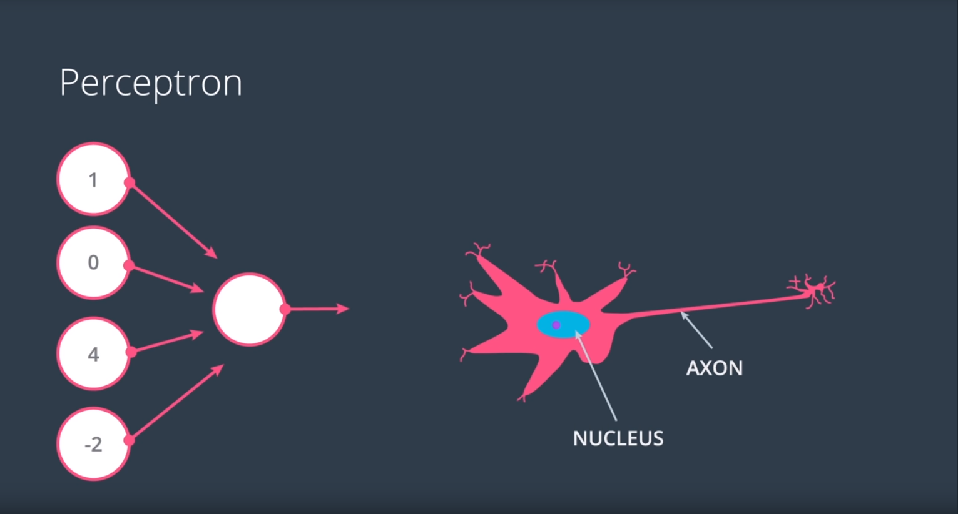
Deep learning
Modern Intelligent systems

Slide 4
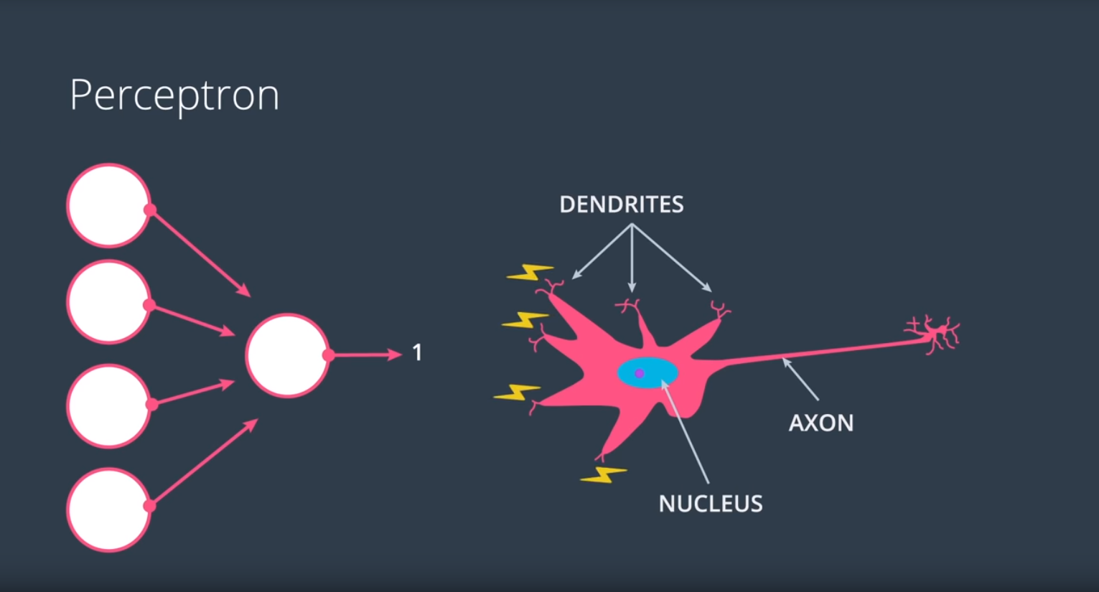
Deep learning
Modern Intelligent systems

Slide 5
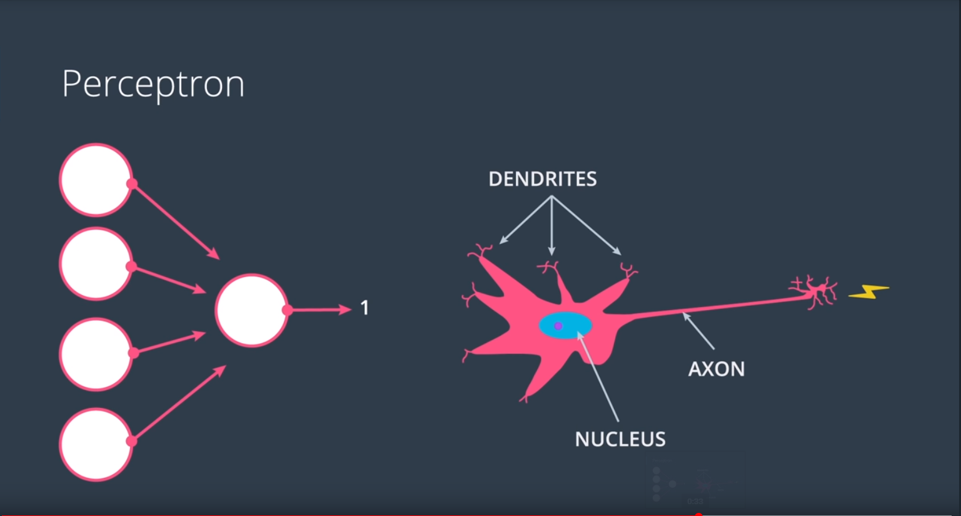
Deep learning
Modern Intelligent systems

Slide 6
Perceptron
Main building block of neural networks

Slide 7
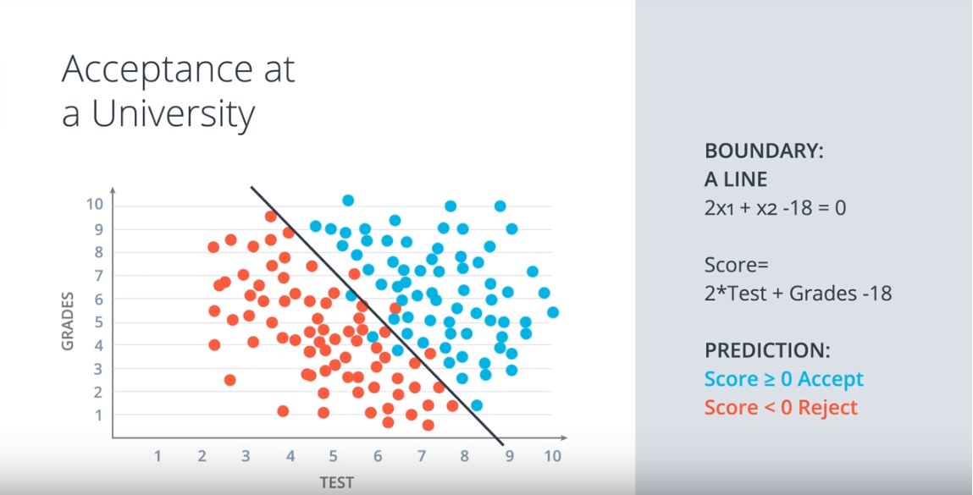
Deep learning
Modern Intelligent systems

Slide 8
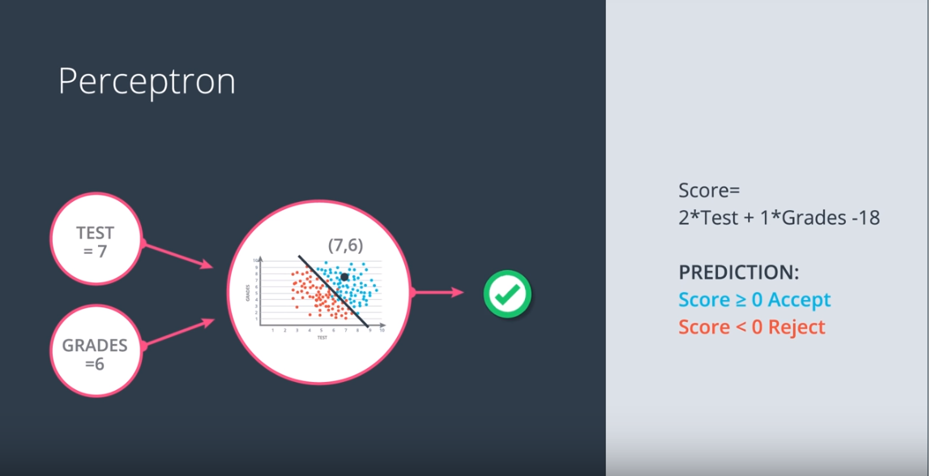
Deep learning
Modern Intelligent systems

Slide 9
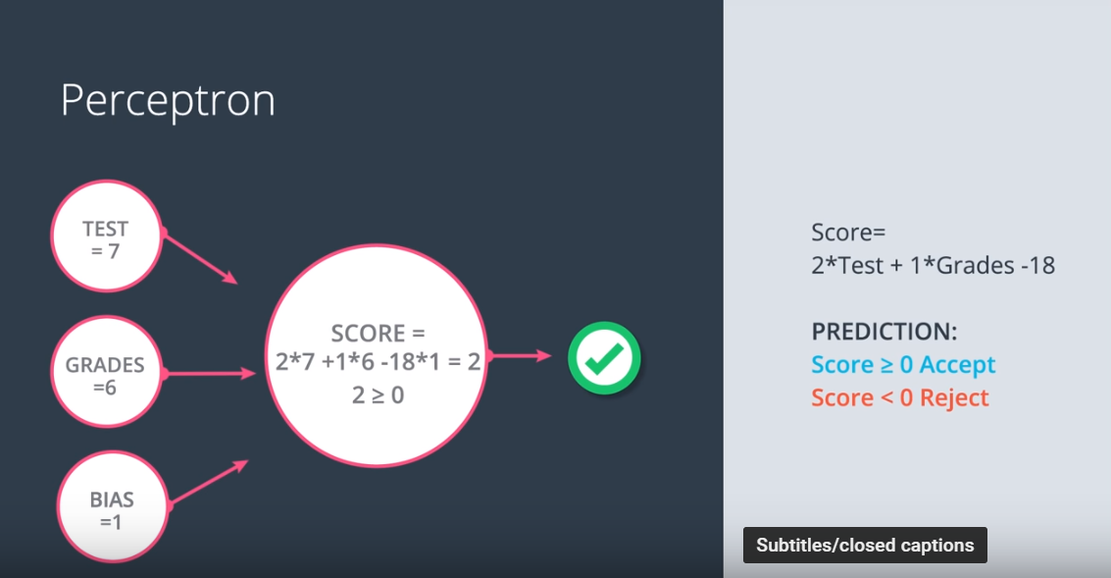
Deep learning
Modern Intelligent systems

Slide 10
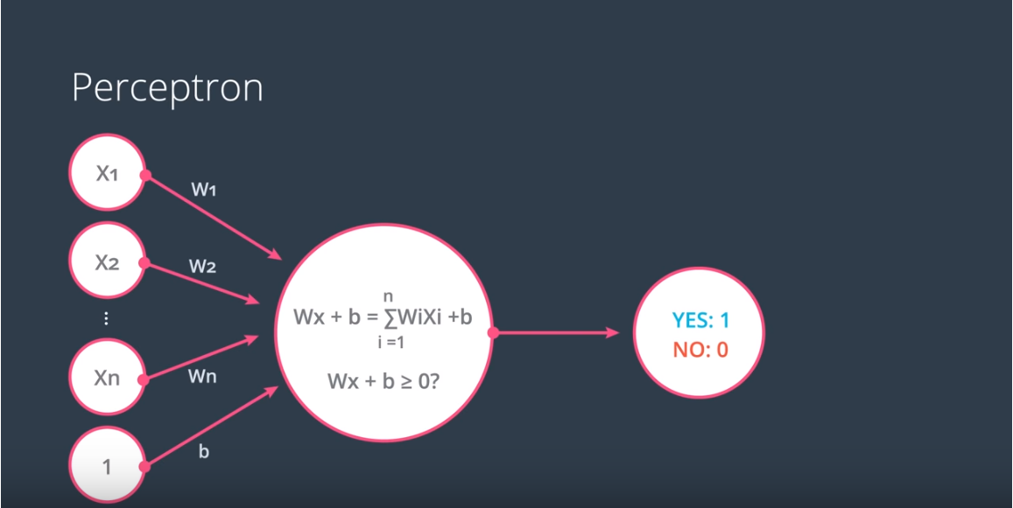
Deep learning
Modern Intelligent systems

Slide 11
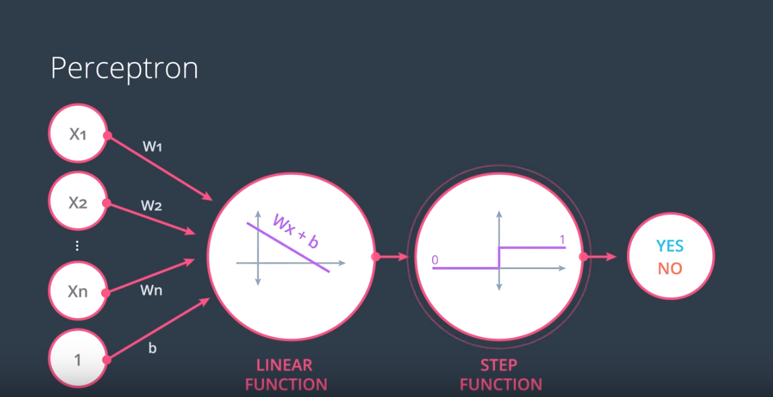
Deep learning
Modern Intelligent systems

Slide 12
Training
Loss Function

Slide 13
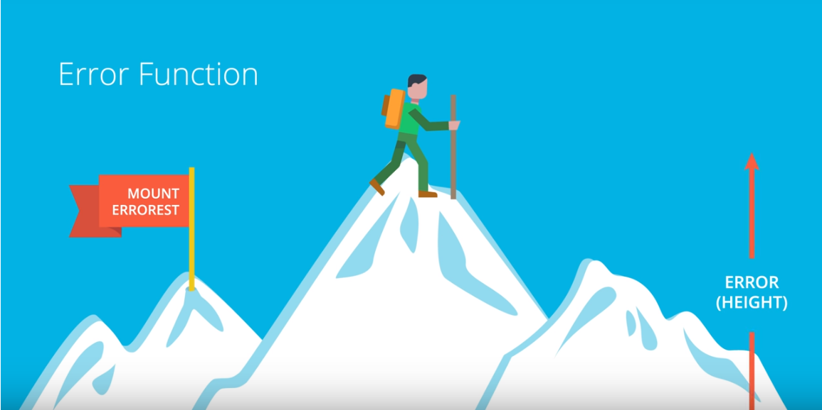
Deep learning
Modern Intelligent systems

Slide 14
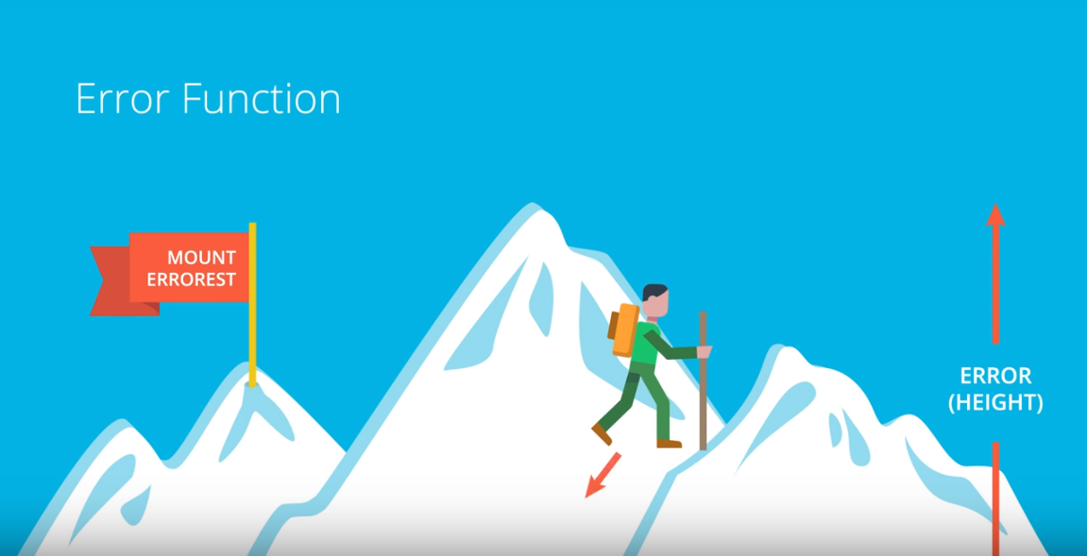
Deep learning
Modern Intelligent systems

Slide 15
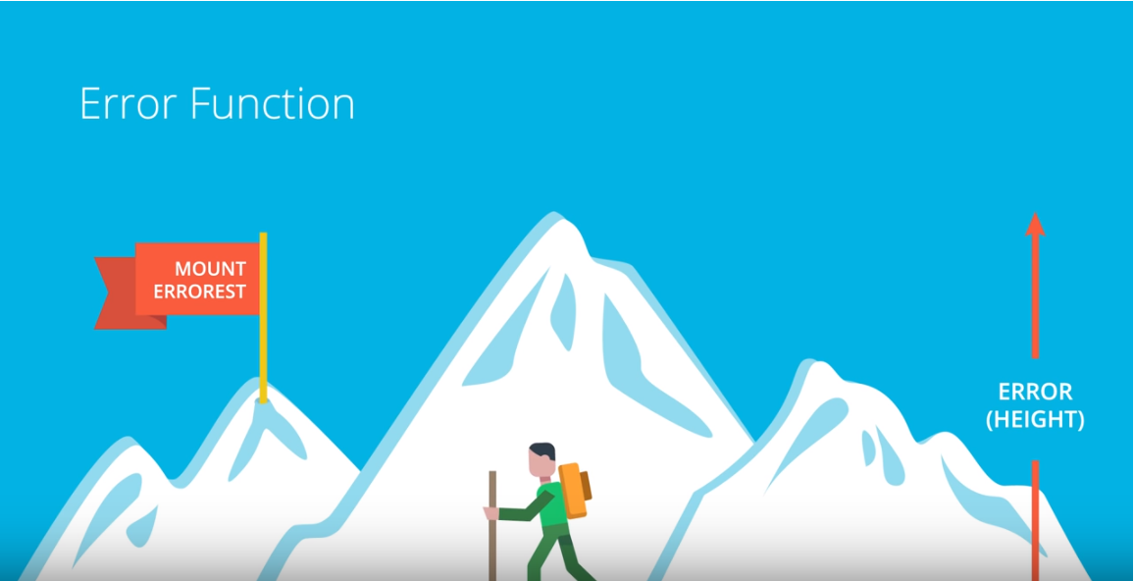
Deep learning
Modern Intelligent systems

Slide 16
Deep learning
What If I get stack in a valley – a local optima?
- Many times local minimum obtains fair performance
How to reach the desired optima ?
- Well known and robust numerical method : Gradient Descend
Modern Intelligent systems

Slide 17
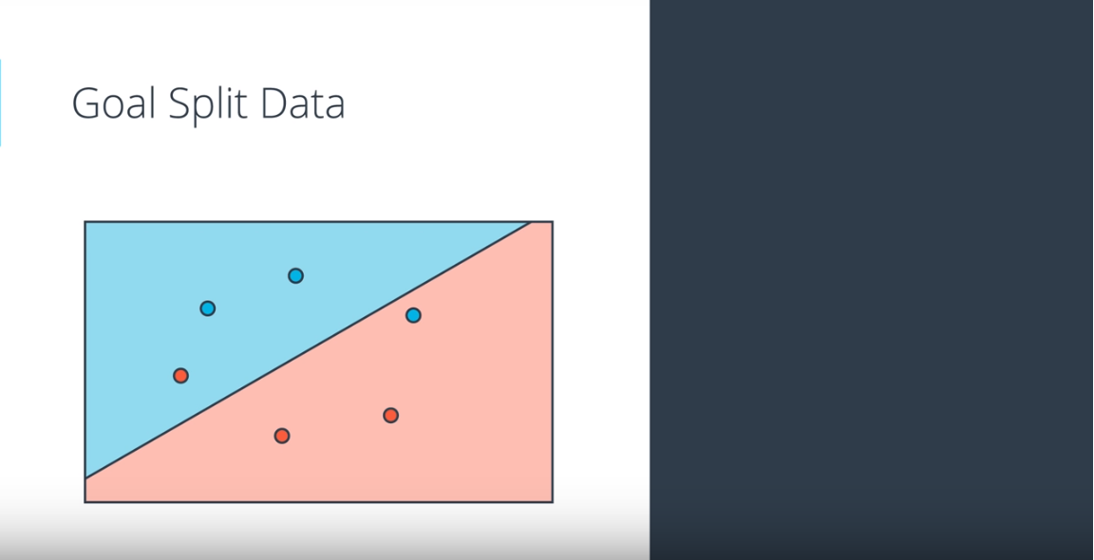
Deep learning
Modern Intelligent systems

Slide 18
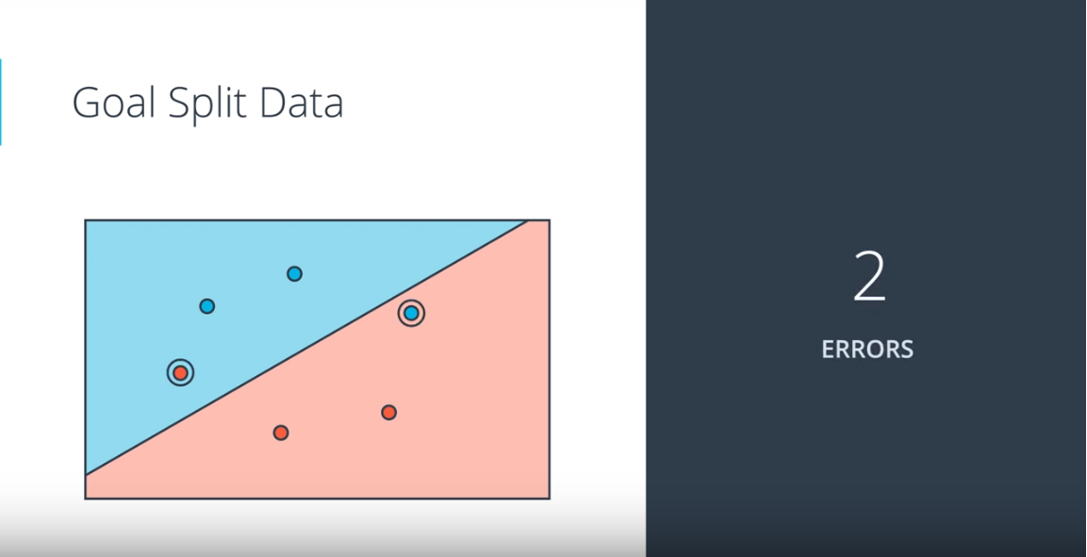
Deep learning
Modern Intelligent systems

Slide 19
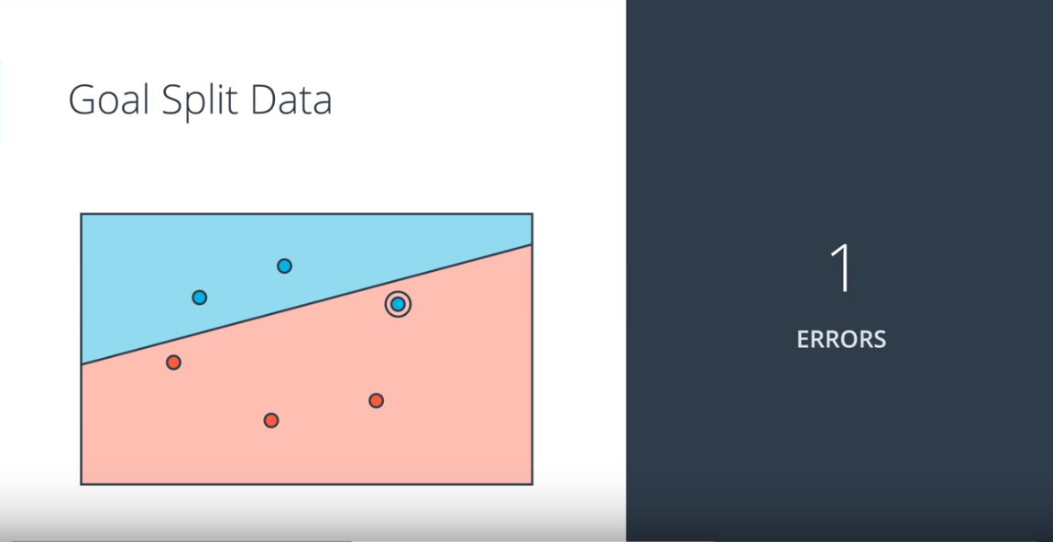
Deep learning
Modern Intelligent systems

Slide 20
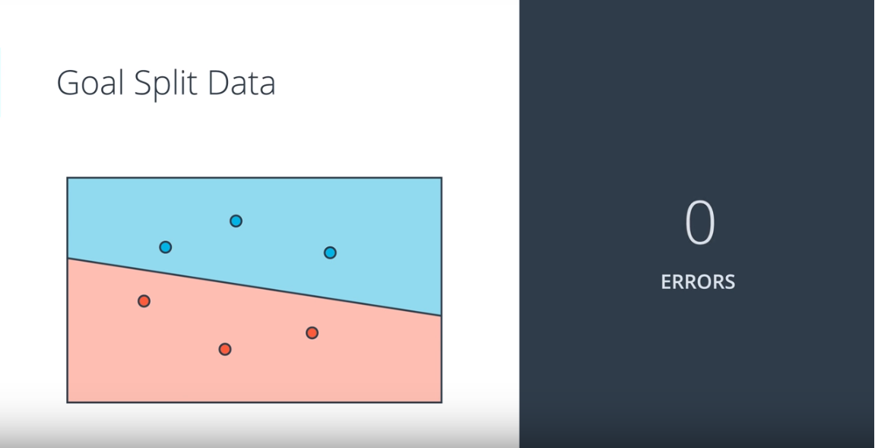
Deep learning
Modern Intelligent systems

Slide 21
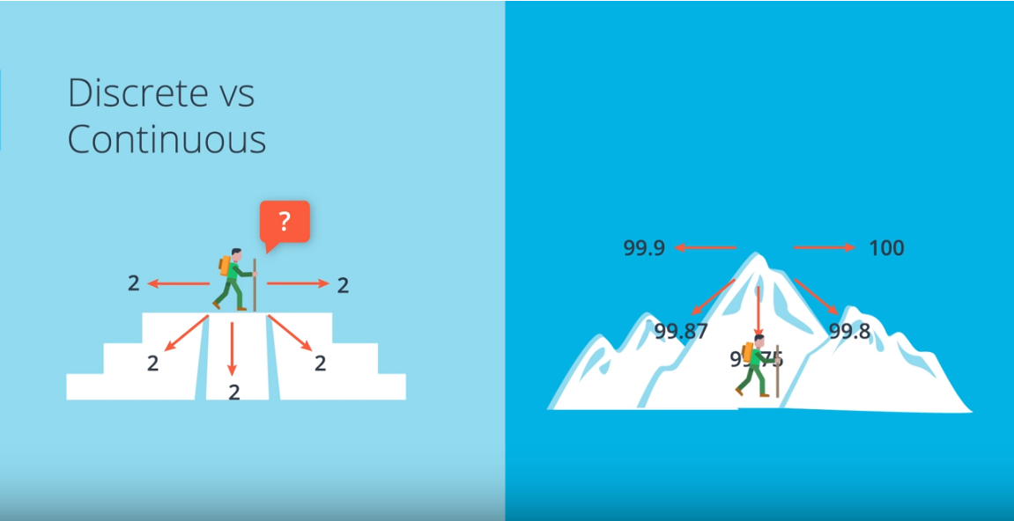
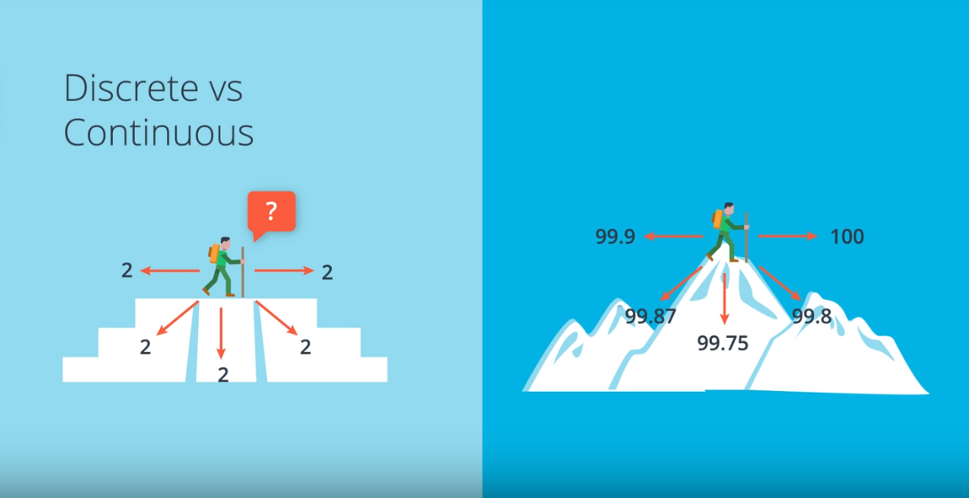
Deep learning
Modern Intelligent systems

Slide 22
Deep learning
Conclusion :
1. Always use continuous loss function
2. In each step, gradient descend gives
the direction of the optimality
Modern Intelligent systems

Slide 23
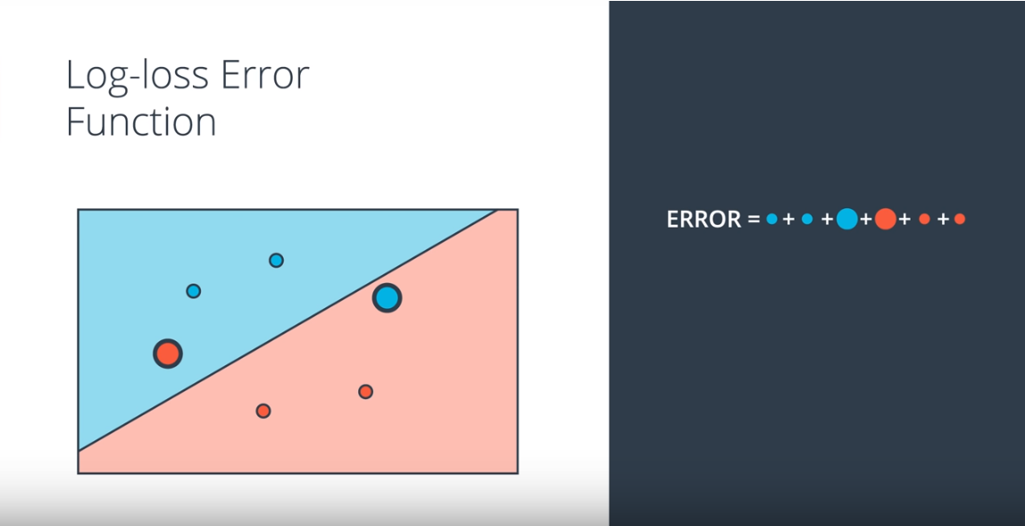
Deep learning
- Huge penalty for miss-classified objects
- Small penalty for correctly-classified objects
Modern Intelligent systems

Slide 24
Training
Sigmoid Function and probability mapping

Slide 25
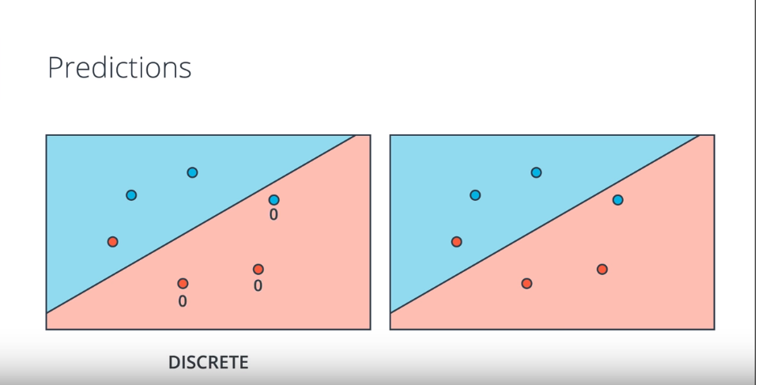
Deep learning
Modern Intelligent systems

Slide 26
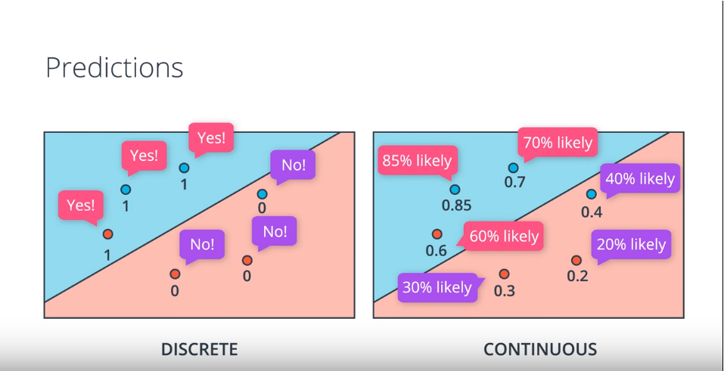
Deep learning
Modern Intelligent systems

Slide 27
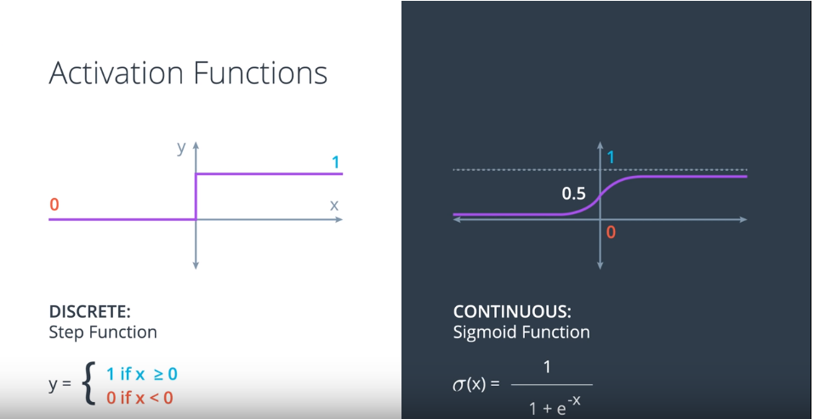
Deep learning
Modern Intelligent systems

Slide 28
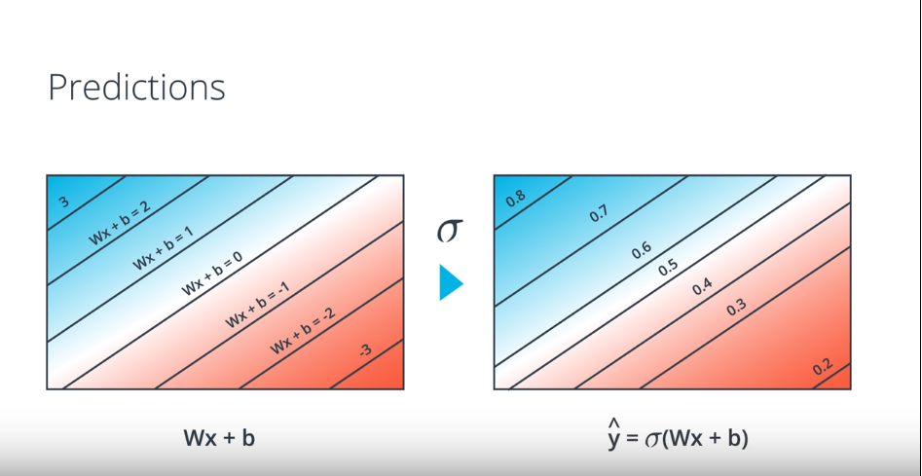
Deep learning
Modern Intelligent systems

Slide 29
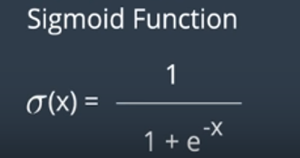
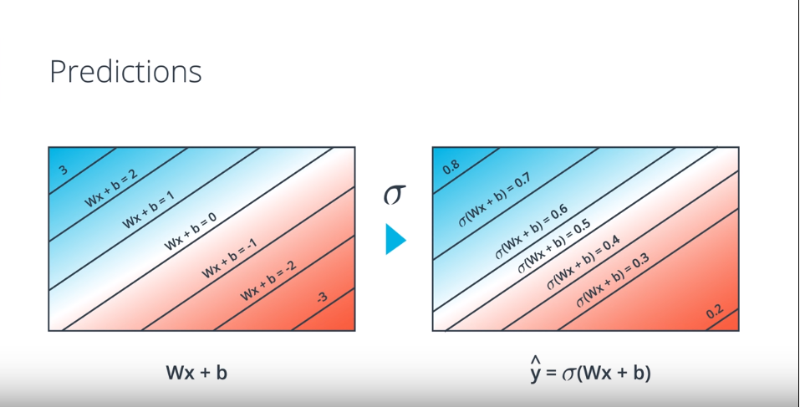
Deep learning
Modern Intelligent systems

Slide 30
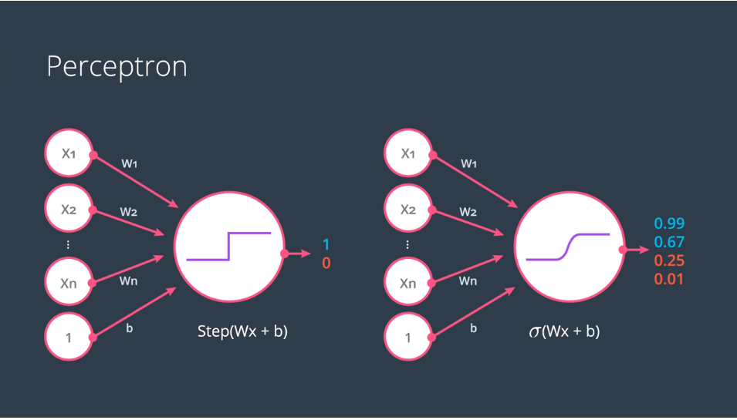
Deep learning
The probability student got accepted is mapped
From discrete [0,1] to continuous [0,1]
Modern Intelligent systems

Slide 31
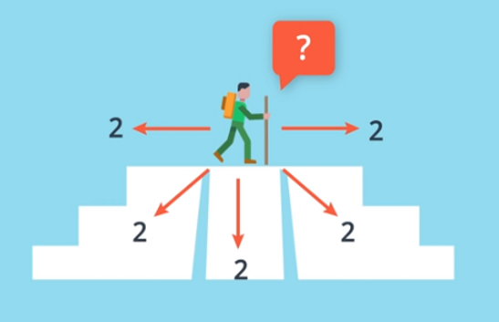
Deep learning
The probability student got accepted is mapped
From discrete [0,1] to continuous [0,1]
Modern Intelligent systems

Slide 32
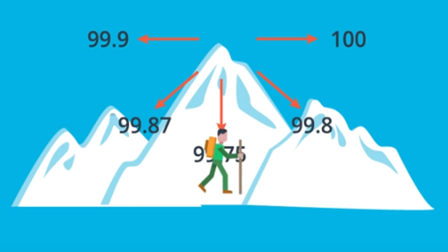
Deep learning
The probability student got accepted is mapped
From discrete [0,1] to continuous [0,1]
Modern Intelligent systems

Slide 33
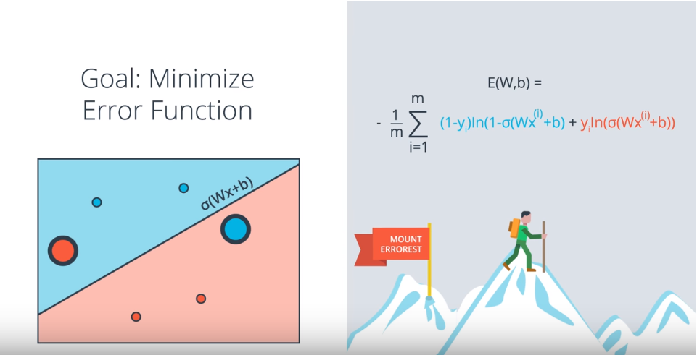
Deep learning
Modern Intelligent systems

Slide 34
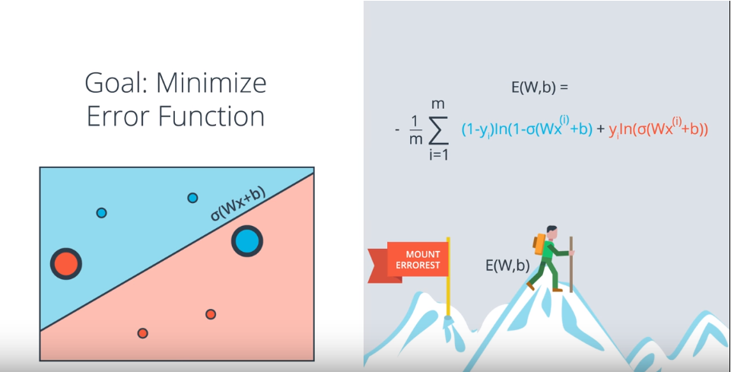
Deep learning
Modern Intelligent systems

Slide 35
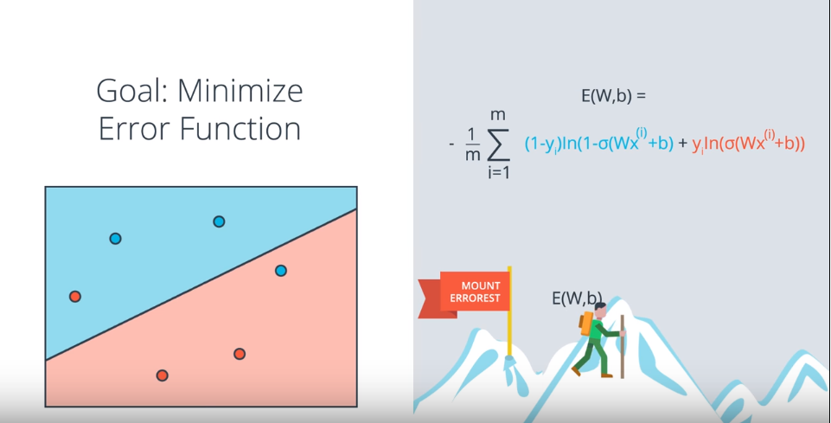
Deep learning
Modern Intelligent systems

Slide 36
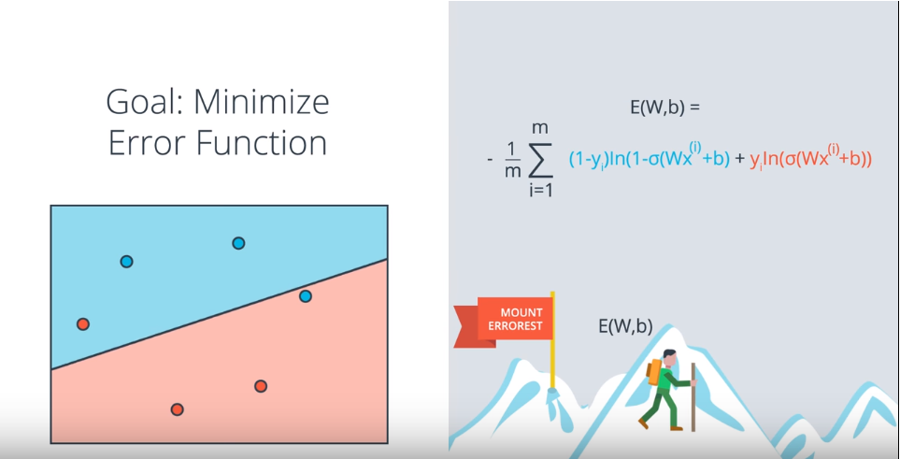
Deep learning
Modern Intelligent systems

Slide 37
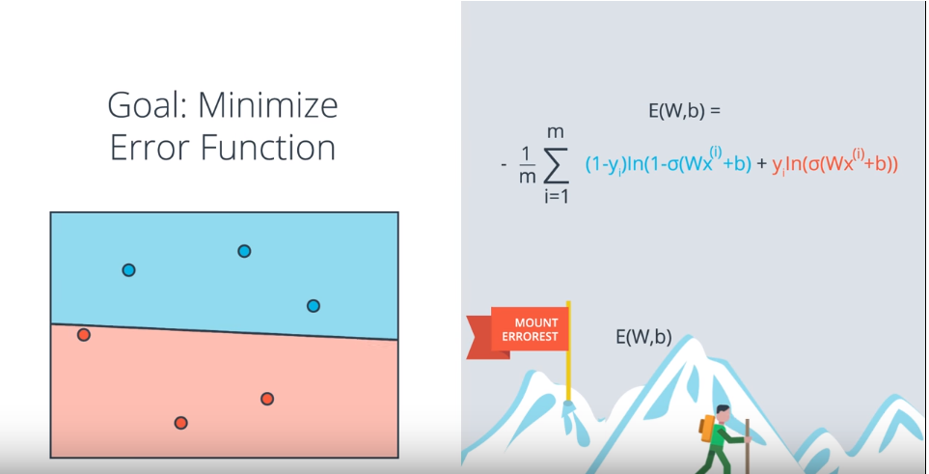
Deep learning
Modern Intelligent systems

Slide 38
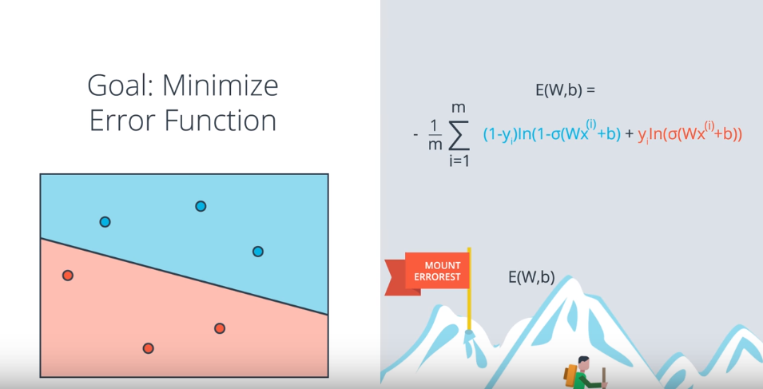
Deep learning
Modern Intelligent systems

Slide 39
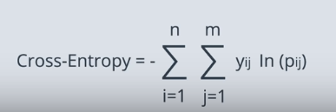
Deep learning
Modern Intelligent systems

Slide 40
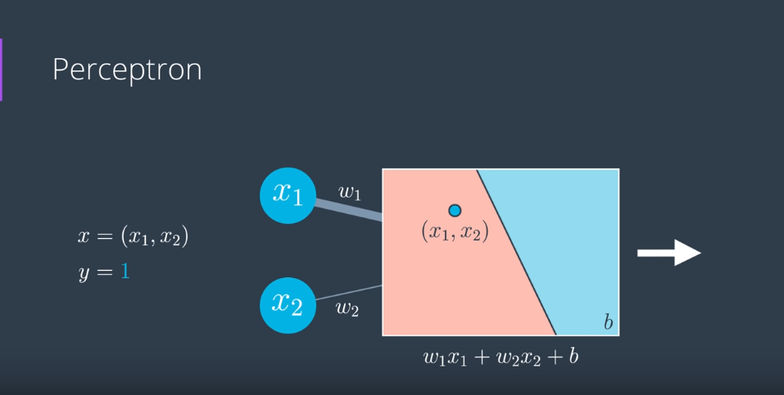
Deep learning
Modern Intelligent systems

Slide 41
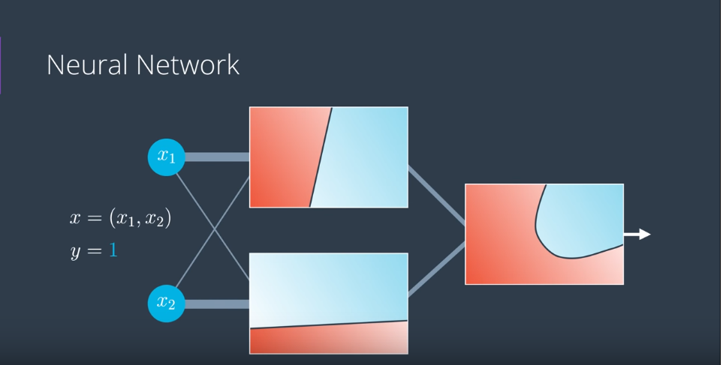
Deep learning
Modern Intelligent systems

Slide 42
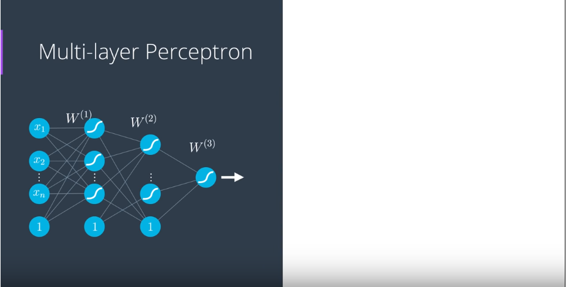
Deep learning
Modern Intelligent systems

Slide 43
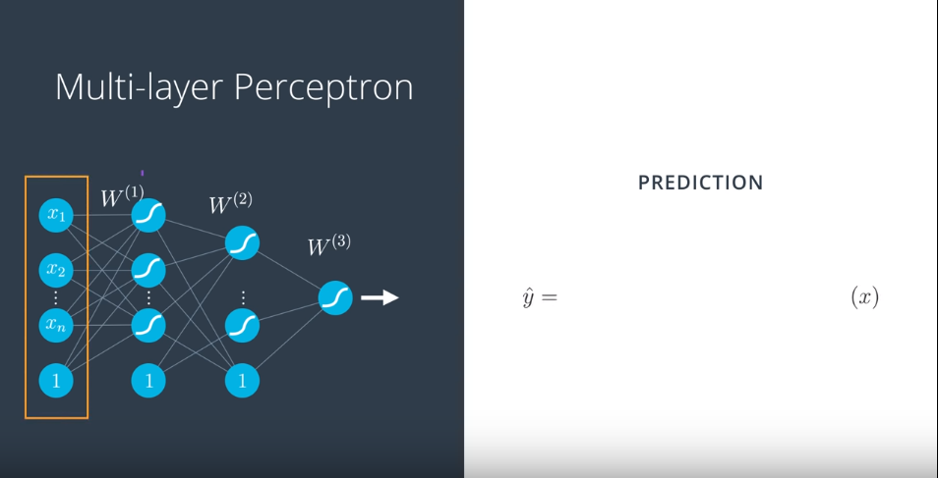
Deep learning
Modern Intelligent systems

Slide 44
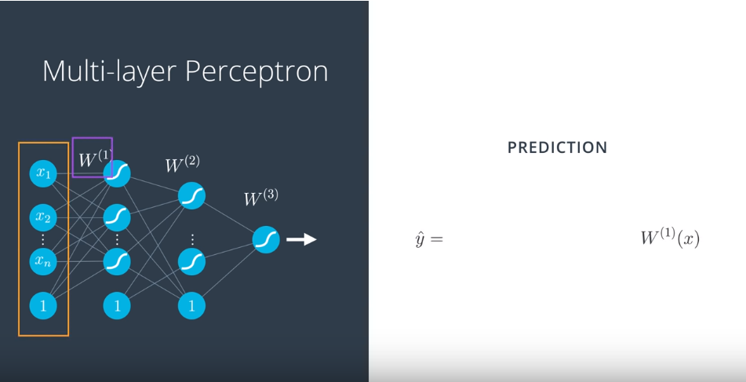
Deep learning
Modern Intelligent systems

Slide 45
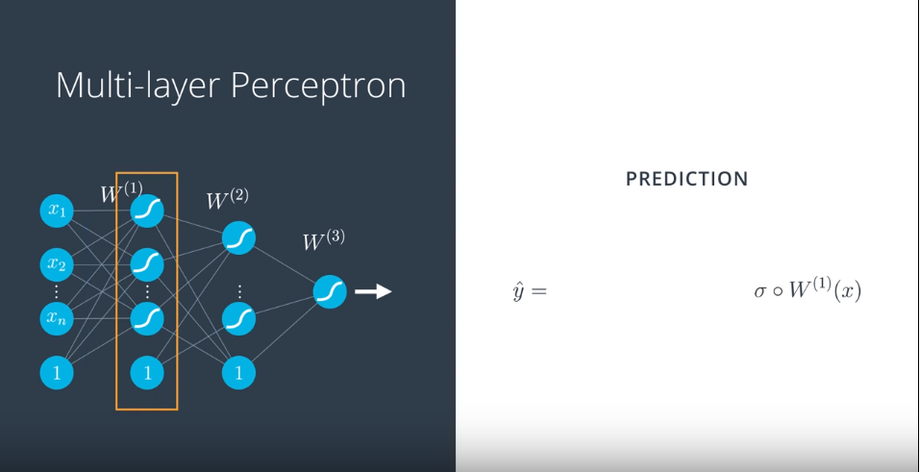
Deep learning
Modern Intelligent systems

Slide 46
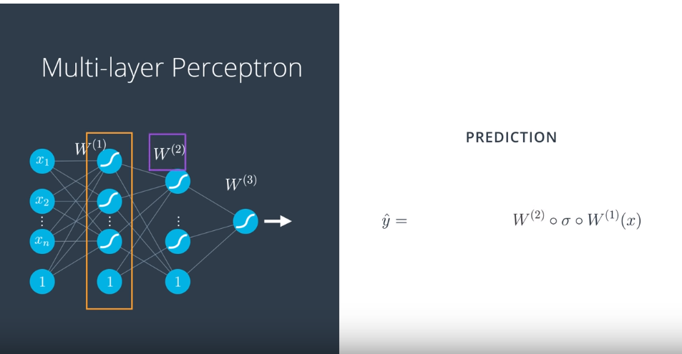
Deep learning
Modern Intelligent systems

Slide 47
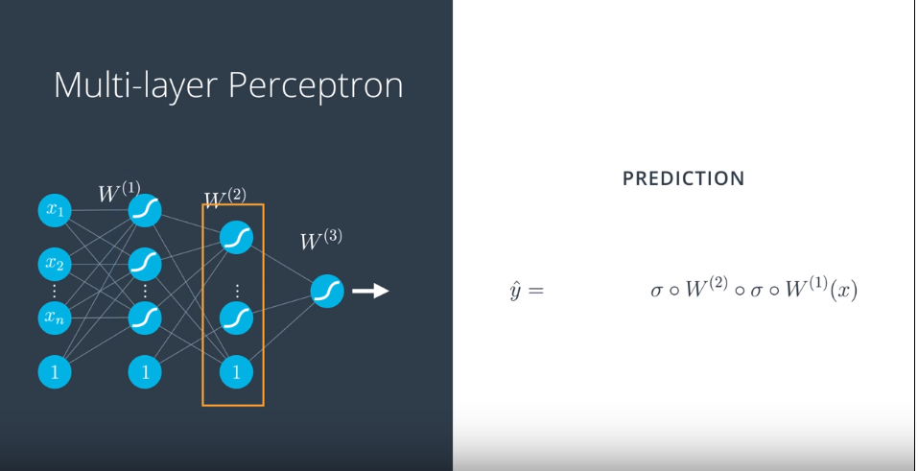
Deep learning
Modern Intelligent systems

Slide 48
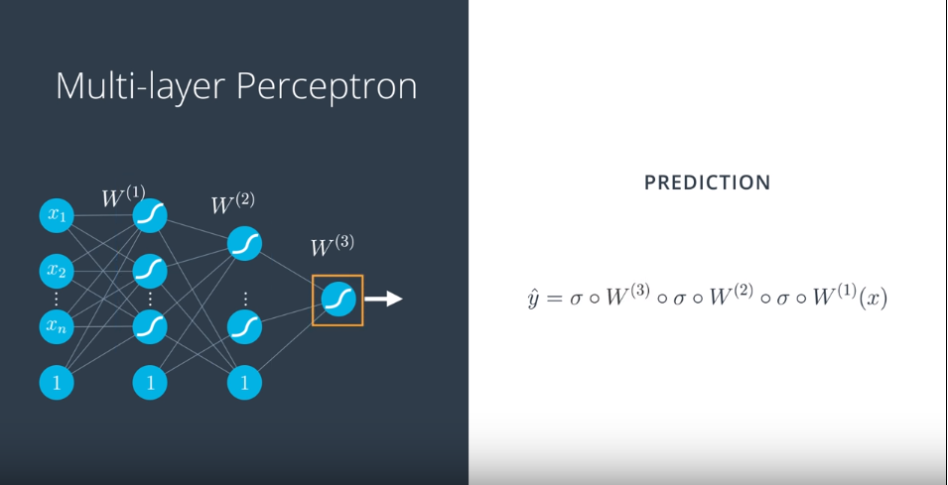
Deep learning
Modern Intelligent systems

Slide 49
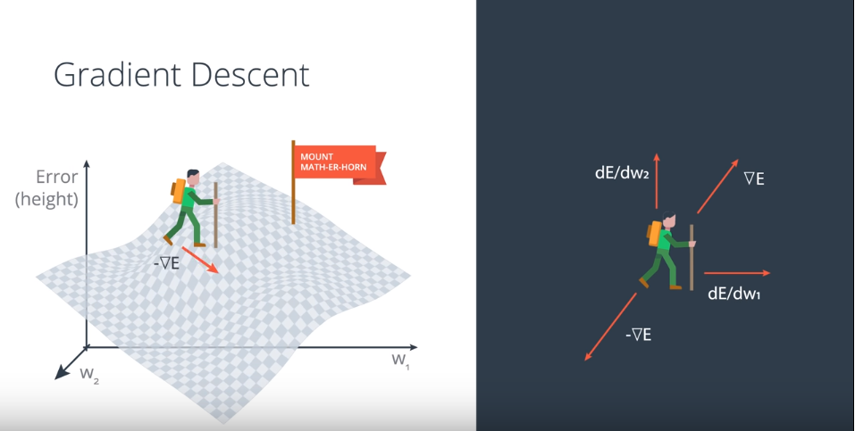
Deep learning
Modern Intelligent systems

Slide 50
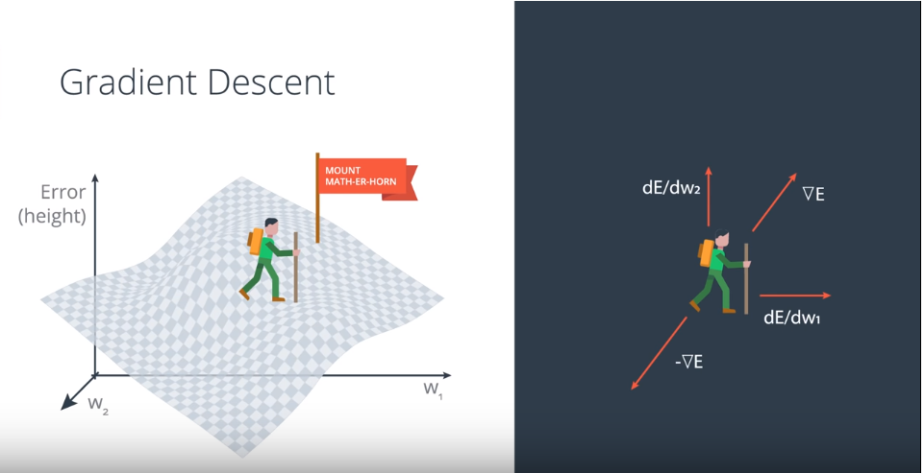
Deep learning
Modern Intelligent systems

Slide 51
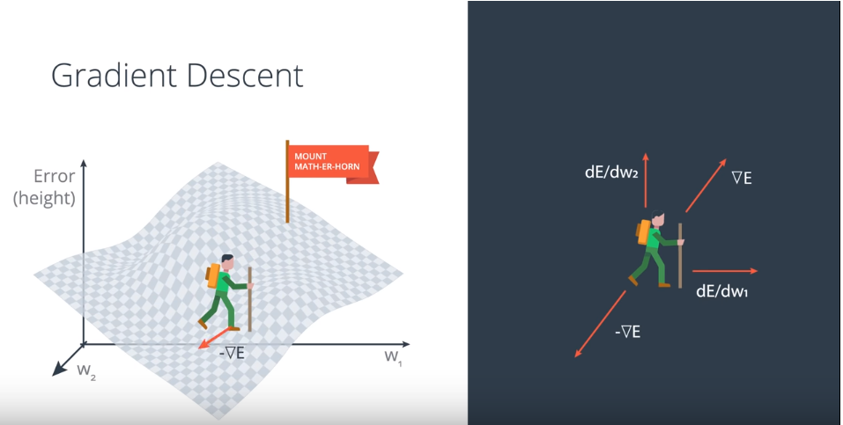
Deep learning
Modern Intelligent systems

Slide 52
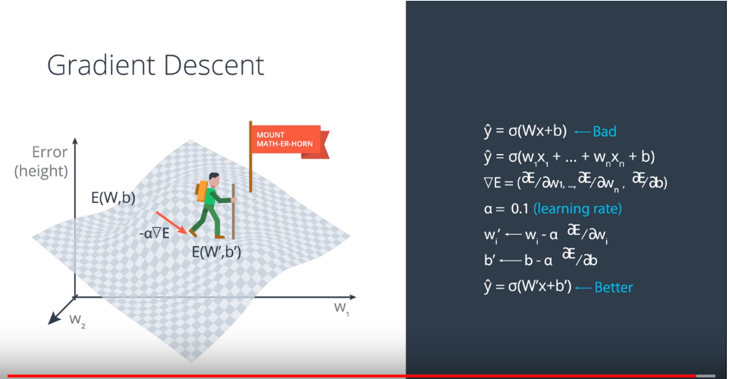
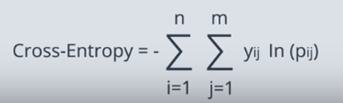
Deep learning
E =
Modern Intelligent systems

Slide 53
Deep learning
Modern Intelligent systems

Slide 54
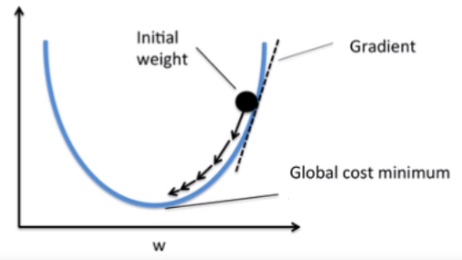
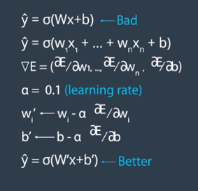

Let ${E=w}^{2}$ ; $\frac{∂E}{∂w}$ = $2w$ $; w$ = 20 ; $α=0.1$ ;

Slide 55

Let ${E=w}^{2}$ ; $\frac{∂E}{∂w}$ = $2w$ $; w$ = 20 ; $α=0.1$ ;
Iteration 1 : w 20 – 0.1 * 2 * 20 = 16

Slide 56

Let ${E=w}^{2}$ ; $\frac{∂E}{∂w}$ = $2w$ $; w$ = 20 ; $α=0.1$ ;
Iteration 1 : w 20 – 0.1 * 2 * 20 = 16
Iteration 2 : w 16 – 0.1 * 2 * 16 = 12.8

Slide 57

Let ${E=w}^{2}$ ; $\frac{∂E}{∂w}$ = $2w$ $; w$ = 20 ; $α=0.1$ ;
Iteration 1 : w 20 – 0.1 * 2 * 20 = 16
Iteration 2 : w 16 – 0.1 * 2 * 16 = 12.8 Iteration 3 : w 12.8 – 0.1 * 2 * 12.8 = 10.24

Slide 58

Deep learning
E =
Modern Intelligent systems

Slide 59



Deep learning
E =
h’
h’’
Modern Intelligent systems

Slide 60
Training
Vanishing gradient problem

Slide 61
Vanishing gradient problem
Hochreiter's diploma thesis of 1991 formally identified the reason for this failure in the "vanishing gradient problem", which affects many-layered networks.

Slide 62

Deep learning
Modern Intelligent systems

Slide 63

Deep learning
Modern Intelligent systems

Slide 64

Deep learning
h’
h’’
Modern Intelligent systems

Slide 65

Deep learning
Modern Intelligent systems

Slide 66

Relu Activation Function
Introduced by Hahnloser et al. in 2000
Strong biological motivations and mathematical justifications.
It has been demonstrated for the first time in 2011 to enable better training of deeper networks
As of 2018, the most popular activation function
for deep neural networks

Slide 67

Deep learning
Modern Intelligent systems

Slide 68

Deep learning
Modern Intelligent systems

Slide 69

Deep learning
Modern Intelligent systems

Slide 70

Deep learning
Modern Intelligent systems

Slide 71
Intelligent Systems
Based on Deep Learning and Neural networks
Lane Detection
Vehicle Detection
Behavior Cloning
Reinforcement learning

Slide 72
Intelligent Systems
Based on Deep Learning and Neural networks
Lane Detection
Vehicle Detection
Behavior Cloning
Reinforcement learning

Slide 73
Intelligent Systems
Based on Deep Learning and Neural networks
Lane Detection
Vehicle Detection
Behavior Cloning
Reinforcement learning

Slide 74
Intelligent Systems
Based on Deep Learning and Neural networks
Lane Detection
Vehicle Detection
Behavior Cloning
Reinforcement learning

Slide 75


Input
Output
Modern Intelligent systems

Slide 76

- Perspective transformation
- Fit to second order polynomial

Slide 77


Slide 78
Intelligent Systems
Based on Deep Learning and Neural networks
Lane Detection
Vehicle Detection
Behavior Cloning
Reinforcement learning

Slide 79


Slide 80


Slide 82


Slide 83
Intelligent Systems
Based on Deep Learning and Neural networks
Lane Detection
Vehicle Detection
Behavior Cloning
Reinforcement learning

Slide 84

Data Collection Step

Slide 85

Training Step

Slide 86

Prediction Step (Feed-Forward)

Slide 87


Slide 88


Slide 89
Intelligent Systems
Based on Deep Learning and Neural networks
Lane Detection
Vehicle Detection
Behavior Cloning
Reinforcement learning

Slide 90


Slide 91
Thank you

